Slide 1
Get Projects
Jatin Yadav - ENG17CS0098
Mayarmui Ruivah - DSU15CS0042
Asfan Ulla – ENG16CS0024

Slide 2
Introduction:
Machine learning is a branch of Artificial Intelligence which is used to analyze the data more smartly.
It automates the process using certain algorithms to minimize human intervention in the process.
In this project we are going to focus on solving the problem of recommending projects to the user.
The aim of this project is to recommend projects using machine learning recommendation algorithm, Matrix Factorization.
The primary goal of the project is to implement the project recommendation.

Slide 3
Problem Statement:
In this machine learning project, we are going to recommend projects to users using ML.NET.
This project will help the users to choose the projects they like from the vast project library and act accordingly.
Here we are going to use matrix factorization to recommend projects. In a nutshell matrix factorization is a class of collaborative filtering algorithms used in recommender systems.
The Score, or the predicted rating is used to determine whether we want to recommend a project to the user.
The higher the Score, the higher the likelihood of a user liking a particular Project.

Slide 4
LITERATURE SURVEY
SL NO | TITLE | AUTHOR | DESCRIPTIVE | RESULT
1 | Deep Matrix Factorization Models for Recommender Systems | Hong-Jian Xue, Xin-Yu Dai, Jianbing Zhang, Shujian Huang, Jiajun Chen | Propose a novel matrix factorization model with a neural network architecture. Through the neural network architecture, users and items are projected into lowdimensional vectors in a latent space. | show the effectiveness of both our proposed model and the loss function.

Slide 5
REQUIREMENT ANALYSIS:
Hardware Requirements:
CPU: Intel Pentium or higher (32/64 bit)
Storage: At least 128 MB free storage space
RAM: At least 128 MB free memory
Software Requirements:
Visual Studio.
ML.NET
.NET Core
LANGUAGES:
C#.

Slide 6
DESIGN
Matrix factorization is a class of collaborative filtering algorithms used in recommender systems.
Matrix factorization algorithms work by decomposing the user-item interaction matrix into the product of two lower dimensionality rectangular matrices.
The recommendation ratings data is split into Train and Test datasets.
The Train data is used to fit our model.
The Test data is used to make predictions with outrained model and evaluate model performance.

Slide 7
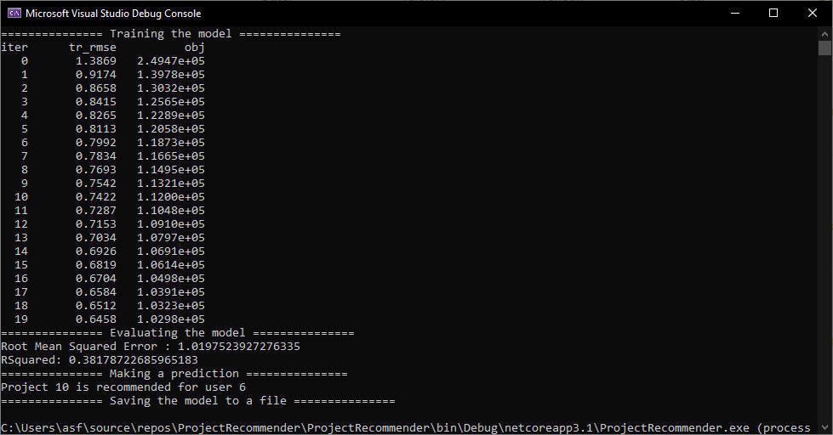
Result

Slide 8
THANK YOU

